Slide 1

Introduction to Desired State Configuration (DSC)
Jeffery Hicks, MVP
jhicks@jdhitsolutions.com
Notes:
Desired State Configuration (DSC) is the last major component of the Monad Manifesto which brought us Windows PowerShell. DSC will change the way you manage your datacenter. Instead of managing a server, you will manage its configuration. DSC is known as a “make it so” technology. You will define a desired server configuration and the server will make it happen. This session will provide an overview to DSC and walk you through setting up a basic configuration.

Slide 2
What is DSC?
An extension to the PowerShell language
Create and manage server configuration files
Ensures servers are always configured the way you need
A local configuration manager does the heavy lifting (V2 only)
Use PowerShell language and cmdlets to create and deploy configurations
Create configuration scripts
Uses PowerShell syntax

Slide 3
Why DSC?
Separate configuration from implementation
“Continuous” server deployment
Manage servers on-site or in a cloud
Leverage your existing PowerShell skills
Prevent server configuration “drift”

Slide 4
V2 Requirements
Windows PowerShell 5.1
PowerShell Remoting
Access to the PowerShell Gallery
DSC-aware editor
Optional: PKI for certificates

Slide 5
DSC Phases
Staging Phase
“Make It So” Phase
Can include imperative and declarative commands
Declarative MOFs staged
Declarative configurations implemented through imperative providers
Create MOF definitions
Configuration calculated per node
Authoring Phase

Slide 6
Creating a Configuration
Defined in a PowerShell script
Configuration keyword (new command type)
Define Node
Configure resources

Slide 7
DSC Resources
Managed element you define in your configuration
Core resources shipped “out of the box”
Additional “experimental” resources shipped from Microsoft
Community developed resources
You can write your own

Slide 8
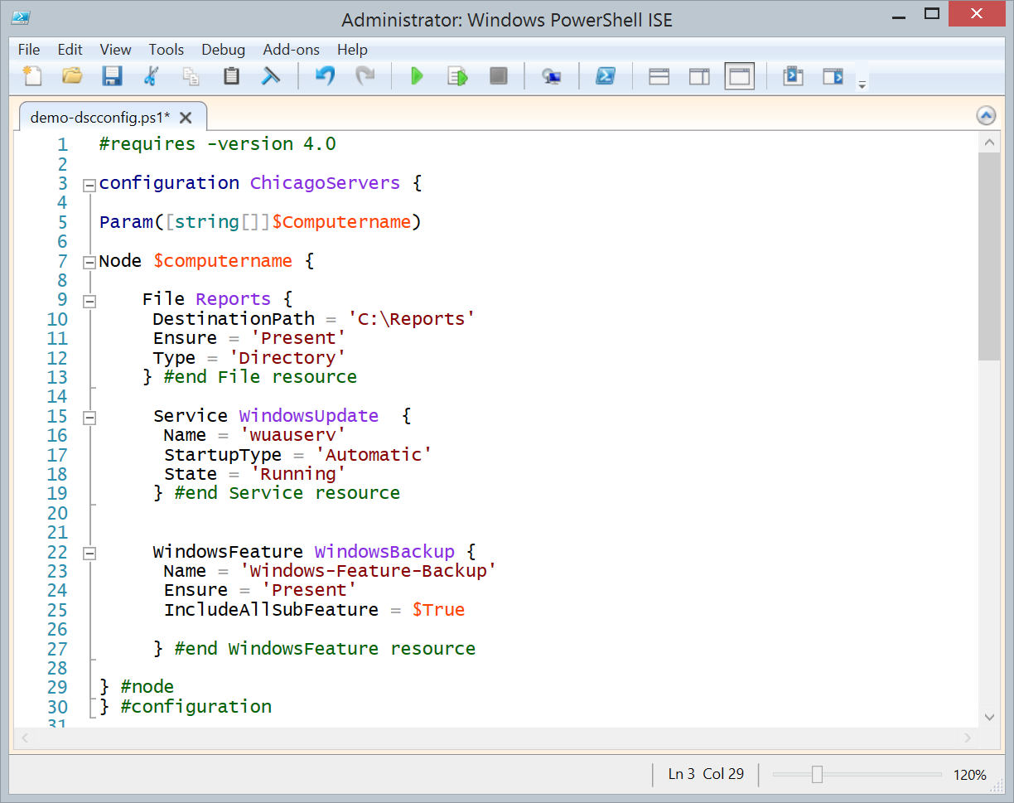
Configuration key word
Desired configuration for nodes
Create a directory
Configure a service
Install a Windows feature

Slide 9
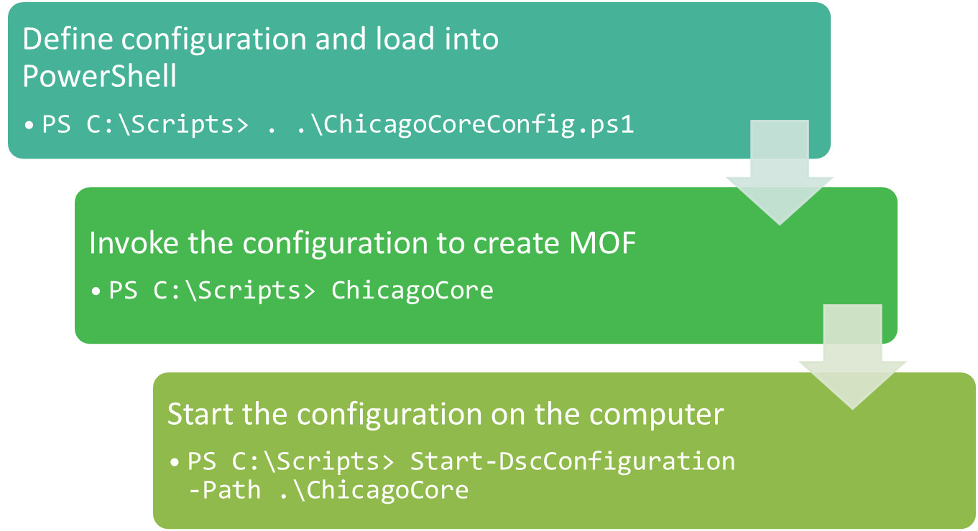
Defines a configuration called ‘ChicagoCore’
Configuration has hard code node names
Configuration pushed to every defined node

Slide 10
Configuration Management is a concept. DSC is a framework. You will need to provide tooling, practices and policies.

